Slide 1
Green Bus Ticketing System
Supervisor: Kiều Trọng Khánh
Members:
Đỗ Ngọc Hoàng - SE61246 – Team Leader
Trần Quang Trường – SE61129
Đoàn Minh Đức - SE61486

Slide 2
Overview
Scenarios Problems
Team’s Proposal
Team’s Solution
Feature explanations and Demo
Advantages and Disadvantages
Future Plan

Slide 3

Introduction
Notes:
1. Tiết kiệm chi phí
2. Giảm ùn tắc giao thông
3. Hạn chế căng thẳng
4. Hạn chế được các tác động thời tiết bên ngoài
5. Có nhiều thời gian trò chuyện cùng bạn bè hơn

Slide 4

Introduction

Slide 5




1. Scenario Problems
Student A takes a bus to school.
FPT-University
Student A

Slide 6
Current Process
Student A
Notes:
Đi xe buýt mua vé trực tiếp
Lên xe
Mua vé từ nhân viên
Nhận vé từ nhân viên (có thế nhận tiền thừa)
=> Mất thời gian không hiệu quả và chủ động

Slide 7


Current Process
Staff B
1. Buy ticket
Student A
Notes:
Đi xe buýt mua vé trực tiếp
Lên xe
Mua vé từ nhân viên
Nhận vé từ nhân viên (có thế nhận tiền thừa)
=> Mất thời gian không hiệu quả và chủ động

Slide 8

Current Process
Staff B
1. Buy ticket
2. Receive ticket
Student A
Notes:
Đi xe buýt mua vé trực tiếp
Lên xe
Mua vé từ nhân viên
Nhận vé từ nhân viên (có thế nhận tiền thừa)
=> Mất thời gian không hiệu quả và chủ động

Slide 9


Current Process’s Problems
Current Process
- Prepare small changes
- Wait for staff to sell ticket
- Receive changes
Problems:
Waste a lot of time
Inconvenience

Slide 10

Current Process Overview for monthly ticket
Bus Station / Office
Student A
Notes:
Sử dụng vé tháng
Muốn có vé tháng
Đến trụ sở hoặc bến xe để mua
Nhận 1 tập vé từ nhân viên
Lên xe buýt
Đưa vé tháng cho nhân viên
Nhận lại 1 vé xác nhận
=>

Slide 11
Current Process Overview for monthly ticket
Bus Station / Office
1. Buy monthly ticket
Student A
Notes:
Sử dụng vé tháng
Muốn có vé tháng
Đến trụ sở hoặc bến xe để mua
Nhận 1 tập vé từ nhân viên
Lên xe buýt
Đưa vé tháng cho nhân viên
Nhận lại 1 vé xác nhận
=>

Slide 12

Current Process Overview for monthly ticket
Bus Station / Office
1. Buy monthly ticket
2. Receive tickets
Student A
Notes:
Sử dụng vé tháng
Muốn có vé tháng
Đến trụ sở hoặc bến xe để mua
Nhận 1 tập vé từ nhân viên
Lên xe buýt
Đưa vé tháng cho nhân viên
Nhận lại 1 vé xác nhận
=>

Slide 13
Current Process Overview for monthly ticket
Bus Station / Office
1. Buy monthly ticket
3. Get on bus
2. Receive tickets
Student A
Notes:
Sử dụng vé tháng
Muốn có vé tháng
Đến trụ sở hoặc bến xe để mua
Nhận 1 tập vé từ nhân viên
Lên xe buýt
Đưa vé tháng cho nhân viên
Nhận lại 1 vé xác nhận
=>

Slide 14
Current Process Overview for monthly ticket
Bus Station / Office
Staff B
3. Get on bus
4. Give prepaid ticket to staff
1. Buy monthly ticket
2. Receive tickets
Student A
Notes:
Sử dụng vé tháng
Muốn có vé tháng
Đến trụ sở hoặc bến xe để mua
Nhận 1 tập vé từ nhân viên
Lên xe buýt
Đưa vé tháng cho nhân viên
Nhận lại 1 vé xác nhận
=>

Slide 15

Current Process Overview for monthly ticket
Bus Station / Office
Staff B
3. Get on bus
4. Give prepaid ticket to staff
1. Buy monthly ticket
2. Receive tickets
5. Receive bus ticket
Student A
Notes:
Sử dụng vé tháng
Muốn có vé tháng
Đến trụ sở hoặc bến xe để mua
Nhận 1 tập vé từ nhân viên
Lên xe buýt
Đưa vé tháng cho nhân viên
Nhận lại 1 vé xác nhận
=>

Slide 16
Monthly ticket process’s problems
Current Process
Go to station/office to buy tickets months
Wait for staff to check ticket
Problems:
Lost of time to check
Buy ticket again
Not priority
Change ticket

Slide 17
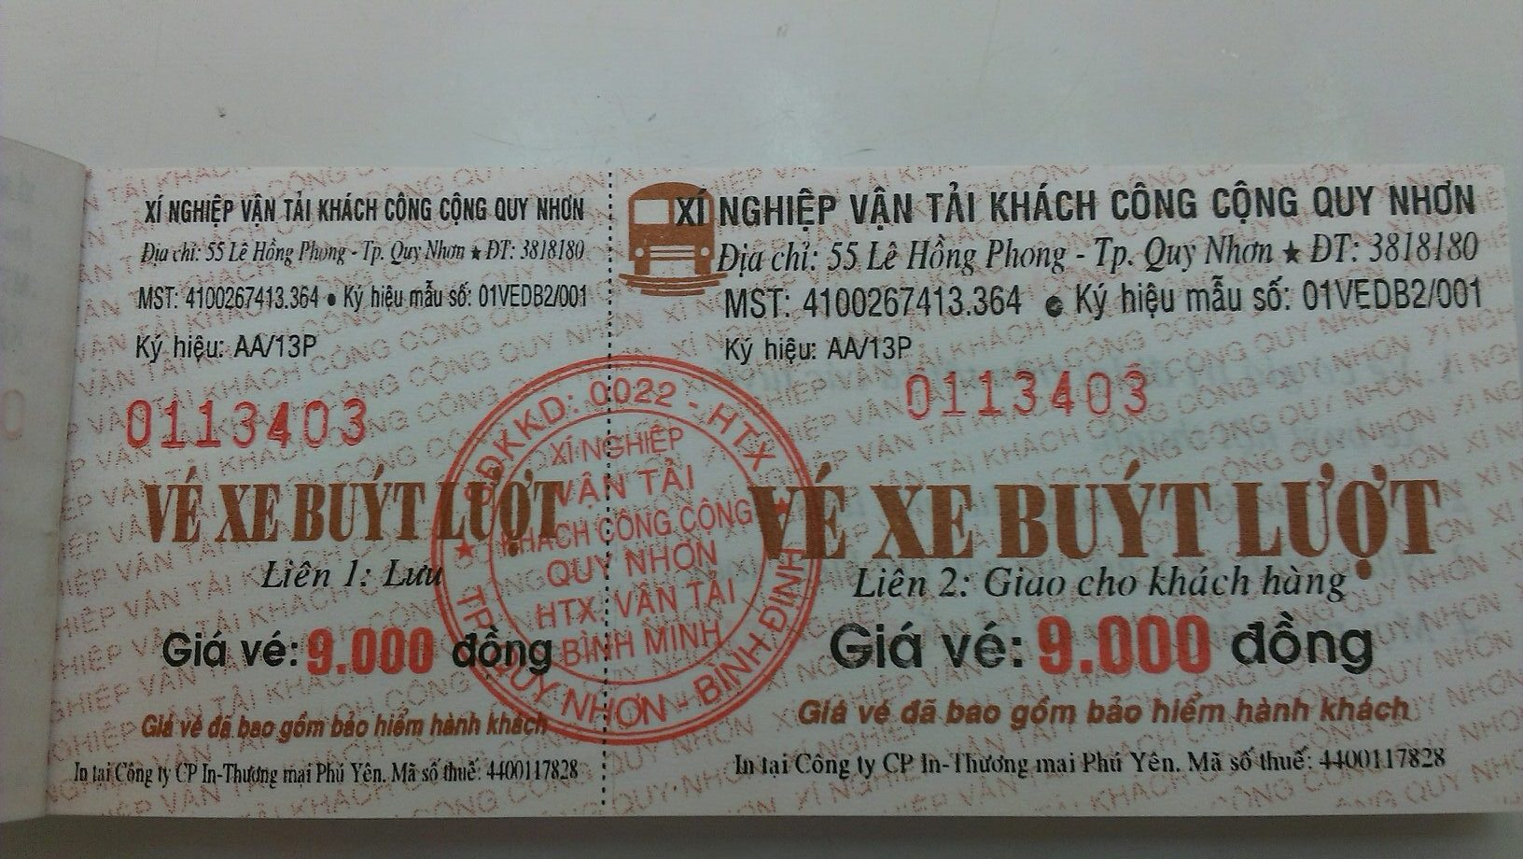
Ticket Material
Ticket is a paper
Notes:
Làm giả vé xe buýt

Slide 18
Ticket Material
Problems:
Printing cost
Not eco-friendly
Not reusable
Ticket is a paper
Notes:
Làm giả vé xe buýt

Slide 19
Current Process Overview
Bus Station / Office
Staff B
3. Get on bus
4. Give prepaid ticket to staff
1. Buy monthly ticket
2. Receive tickets
5. Receive bus ticket
Student A
Notes:
Sử dụng vé tháng
Muốn có vé tháng
Đến trụ sở hoặc bến xe để mua
Nhận 1 tập vé từ nhân viên
Lên xe buýt
Đưa vé tháng cho nhân viên
Nhận lại 1 vé xác nhận
=>

Slide 20
Our Process
Bus Station / Office
Staff B
3. Get on bus
4. Give prepaid ticket to staff
1. Buy monthly ticket
2. Receive tickets
5. Receive bus ticket
Student A
Notes:
Sử dụng vé tháng
Muốn có vé tháng
Đến trụ sở hoặc bến xe để mua
Nhận 1 tập vé từ nhân viên
Lên xe buýt
Đưa vé tháng cho nhân viên
Nhận lại 1 vé xác nhận
=>

Slide 21

Our Process
Bus Station / Office
Staff B
3. Get on bus
4. Give prepaid ticket to staff
1. Buy card
2. Receive card
5. Receive bus ticket
Student A
Notes:
Sử dụng vé tháng
Muốn có vé tháng
Đến trụ sở hoặc bến xe để mua
Nhận 1 tập vé từ nhân viên
Lên xe buýt
Đưa vé tháng cho nhân viên
Nhận lại 1 vé xác nhận
=>

Slide 22
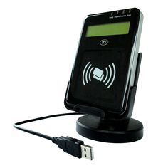
Our Process
Bus Station / Office
3. Get on bus
4. Give prepaid ticket to staff
1. Buy card
2. Receive card
5. Receive bus ticket
Student A
Notes:
Sử dụng vé tháng
Muốn có vé tháng
Đến trụ sở hoặc bến xe để mua
Nhận 1 tập vé từ nhân viên
Lên xe buýt
Đưa vé tháng cho nhân viên
Nhận lại 1 vé xác nhận
=>

Slide 23
Our Process
Bus Station / Office
1. Buy card
3. Get on bus
4. Tap card
2. Receive card
Student A
Notes:
Sử dụng vé tháng
Muốn có vé tháng
Đến trụ sở hoặc bến xe để mua
Nhận 1 tập vé từ nhân viên
Lên xe buýt
Đưa vé tháng cho nhân viên
Nhận lại 1 vé xác nhận
=>

Slide 24
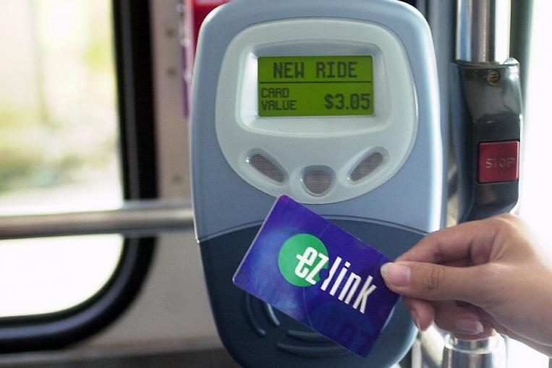
Similar System in Singapore

Slide 25
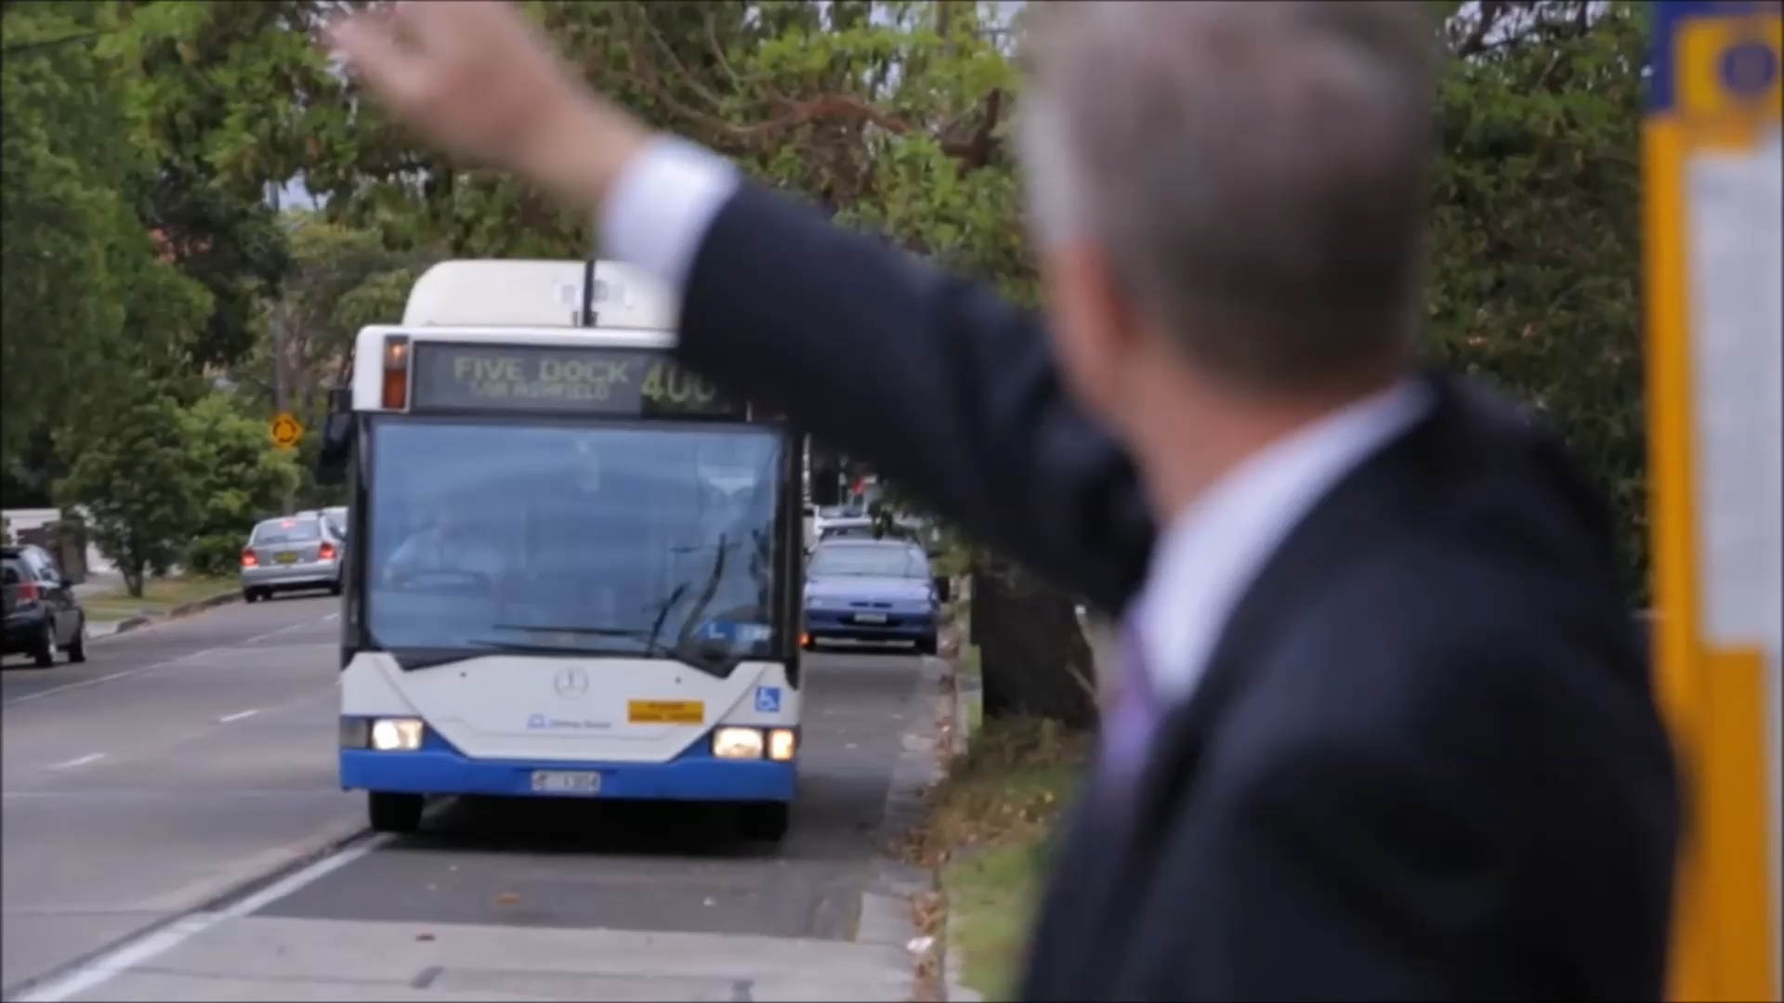

Slide 26

Technology
Use short-range radio-frequency identification technology (RFID) technologies
Near Field Communication

Slide 27
Technology
Use short-range radio-frequency identification technology (RFID) technologies
Exchange data within 4 cm or less
Near Field Communication

Slide 28
Technology
Use short-range radio-frequency identification technology (RFID) technologies
Exchange data within 4 cm or less
Supply power to and communicate with an unpowered and passive electronic tag
Near Field Communication

Slide 29

Our proposal - Summary
Center management application
Simulation for publishing card or reading card
Web application
NFC writer/reader
Deliver to passenger
Passenger’s application
NFC card
Mobile application

Slide 30

Main features

Slide 31
Main features
Publish card

Slide 32
Main features
Publish card
Buy ticket

Slide 33
Main features
Publish card
Buy ticket
Top up card

Slide 34
Main features
Publish card
Buy ticket
Top up card
Activate card

Slide 35
Main features
Publish card
Buy ticket
View report
Top up card
Activate card
Notes:
-manage card
+ 5 cai
-support
+ tim duong
+ tin khuyen mai
-export report
+ view report search. 3 card
-Manage account
View income/ montly

Slide 36
Main features
Publish card

Slide 37
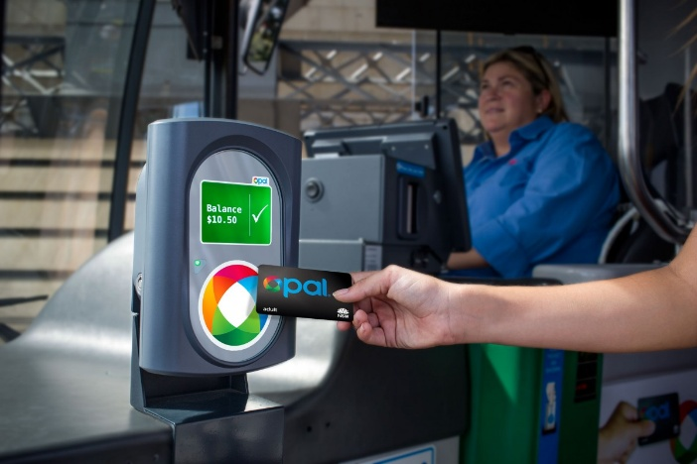
Main features
Buy ticket
By card

Slide 38
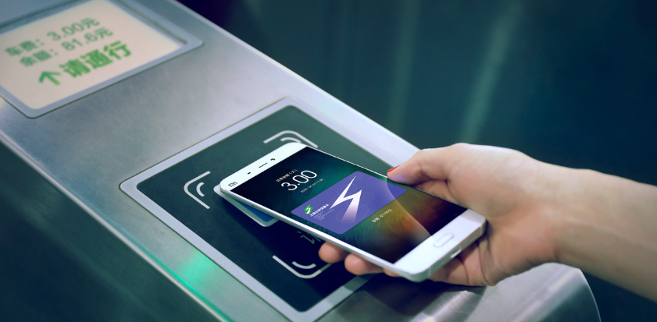
Main features
Buy ticket
By card
By phone

Slide 39

Main features
Top up
PayPal

Slide 40

Main features
Top up
PayPal
Cash

Slide 41
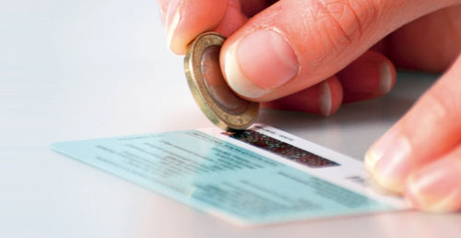
Main features
Top up
PayPal
Cash
Scratch card

Slide 42

Main features
View report
$.....

Slide 43
Main features
View report
Total money spent
$.....

Slide 44
Main features
View report
Total money spent
Number of tickets bought
$.....

Slide 45
Main features
View report
Total money spent
Number of tickets bought
$.....
Frequently traveled bus routes

Slide 46
Features explanation

Slide 47
Card
NFC card

Slide 48
Card
Card
UniqueIdentifier
Manufacturer ID
NFC card

Slide 49
Card
Card
UniqueIdentifier
Balance
NFC card

Slide 50
Card
Card
UniqueIdentifier
Balance
Status
NFC card

Slide 51
Card
Card
UniqueIdentifier
Balance
Status
UserID
NFC card

Slide 52
Card
Card
ID
UniqueIdentifier
Balance
Status
UserID
NFC card

Slide 53
Ticket

Slide 54
Ticket
Ticket
ID

Slide 55
Ticket
Ticket
ID
CardID

Slide 56
Ticket
Ticket
ID
TicketType
CardID
ID
TicketTypeID
…

Slide 57
Ticket
Ticket
ID
CardID
BusRoute
TicketTypeID
ID
BusRouteID
…

Slide 58
Ticket
Ticket
ID
CardID
TicketTypeID
BusRouteID
Total

Slide 59
Ticket
Ticket
ID
CardID
TicketTypeID
BusRouteID
Total
BoughtDate

Slide 60
Ticket
Ticket
ID
CardID
TicketTypeID
BusRouteID
Total
BoughtDate
IsNoCard

Slide 61
User
User
PhoneNumber
User

Slide 62
User
User
PhoneNumber
Password
User

Slide 63
User
User
PhoneNumber
Password
Fullname
User

Slide 64
User
User
PhoneNumber
Password
Fullname
Status
User

Slide 65
User
User
Role
PhoneNumber
ID
Password
Name
Fullname
Status
User
RoleID

Slide 66
Demo 1’s features
Features
Publish card

Slide 67
Demo 1’s features
Features
Publish card
Buy ticket

Slide 68
Demo 1’s Scenario
Student A goes to school by bus for the first time.
Bus Station / Office
1. Buy card
3. Get on bus
4. Tap card
2. Receive card
Student A

Slide 69
Publish Card

Slide 70
Buy ticket
Tap card on bus emulator

Slide 71
How could we do that?

Slide 72
Publish card
Web application
Staff B
DB
Emulator

Slide 73
Publish card
Web application
Staff B
1. Log in and go to publish card feature
DB
Emulator

Slide 74

Publish card
Web application
Staff B
1. Log in and go to publish card feature
DB
2. Tap new card on NFC reader
Emulator

Slide 75
Publish card
Web application
Staff B
1. Log in and go to publish card feature
DB
3. Get card’s ID and send to web application
2. Tap new card on NFC reader
Emulator

Slide 76
Publish card
Web application
Staff B
1. Log in and go to publish card feature
DB
4. Insert new card into database
3. Get card’s ID and send to web application
2. Tap new card on NFC reader
Emulator

Slide 77
Buy ticket
WEB SERVICE
Emulator
Passenger
DB

Slide 78
Buy ticket
1. Tap card on emulator
WEB SERVICE
Emulator
Passenger
DB

Slide 79
Buy ticket
1. Tap card on emulator
2. Send card’s ID to web service
WEB SERVICE
Emulator
Passenger
DB

Slide 80
Buy ticket
1. Tap card on emulator
2. Send card’s ID to web service
WEB SERVICE
Emulator
3. Check the balance of received card’s ID
Passenger
DB

Slide 81
Buy ticket
1. Tap card on emulator
2. Send card’s ID to web service
WEB SERVICE
4. Return result
Emulator
3. Check the balance of received card’s ID
Passenger
DB

Slide 82
Buy ticket
1. Tap card on emulator
2. Send card’s ID to web service
WEB SERVICE
5. Show result
4. Return result
Emulator
3. Check the balance of received card’s ID
Passenger
DB

Slide 83
Demo 2’s Features
Activate card by SMS

Slide 84
Demo 2’s Features
Activate card by SMS
View report

Slide 85
Demo 2’s Features
Activate card by SMS
View report
Buy ticket by phone

Slide 86
Demo 2’s Features
Activate card by SMS
View report
Buy ticket by phone
Top up by PayPal

Slide 87
Demo 2’s Scenario
Scenario:
Passenger A want to:
View card’s balance

Slide 88
Demo 2’s Scenario
Scenario:
Passenger A want to:
View card’s balance
View usage report

Slide 89
Demo 2’s Scenario
Scenario:
Passenger A want to:
View card’s balance
View usage report
Top up

Slide 90
Demo 2’s Scenario
Scenario:
Passenger A want to:
View card’s balance
View usage report
Top up
Use his/her phone to buy ticket

Slide 91
Demo 2’s Scenario
Scenario:
Passenger A want to:
View card’s balance
View usage report
Top up
Use his/her phone to buy ticket
He/she has to activate his/her card first.

Slide 92
Activate card by SMS

Slide 93
View usage report
Passenger’s screen

Slide 94
Buy ticket by phone
Bus emulator screen
Passenger’s screen

Slide 95
Top up by PayPal
Passenger’s screen

Slide 96
How could we do that?

Slide 97

Activate card by SMS
WEB SERVICE
Passenger
DB

Slide 98
Activate card by SMS
1. Send SMS with syntax: DK [Card ID] to 19008198
WEB SERVICE
Passenger
DB

Slide 99
Activate card by SMS
1. Send SMS with syntax: DK [Card ID] to 19008198
2. Send the SMS
WEB SERVICE
Passenger
DB

Slide 100
Activate card by SMS
1. Send SMS with syntax: DK [Card ID] to 19008198
2. Send the SMS
WEB SERVICE
Passenger
3. Insert new user into database
DB

Slide 101
Activate card by SMS
1. Send SMS with syntax: DK [Card ID] to 19008198
2. Send the SMS
WEB SERVICE
Passenger
4. Send an SMS with an auto generated password
3. Insert new user into database
DB

Slide 102
View report
1. Login GBTS mobile app
2. Send view report request
WEB SERVICE
4. Return report
3. Manipulate
Passenger’s phone
DB

Slide 103
Buy ticket by phone
WEB SERVICE
Emulator
DB

Slide 104
Buy ticket by phone
WEB SERVICE
Emulator
1. Login GBTS mobile app and set a default card to pay
DB

Slide 105
Buy ticket by phone
2. Tap phone on emulator to send encrypted data
WEB SERVICE
Emulator
1. Login GBTS mobile app and set a default card to pay
DB

Slide 106
Buy ticket by phone
2. Tap phone on emulator to send encrypted data
3. Decrypt data then send to web service
WEB SERVICE
Emulator
1. Login GBTS mobile app and set a default card to pay
DB

Slide 107
Buy ticket by phone
2. Tap phone on emulator to send encrypted data
3. Decrypt data then send to web service
WEB SERVICE
Emulator
4. Check the balance of received card’s ID
1. Login GBTS mobile app and set a default card to pay
DB

Slide 108
Buy ticket by phone
2. Tap phone on emulator to send encrypted data
3. Decrypt data then send to web service
WEB SERVICE
5. Return result
Emulator
4. Check the balance of received card’s ID
1. Login GBTS mobile app and set a default card to pay
DB

Slide 109
Buy ticket by phone
2. Tap phone on emulator to send encrypted data
3. Decrypt data then send to web service
WEB SERVICE
6. Show result
5. Return result
Emulator
4. Check the balance of received card’s ID
1. Login GBTS mobile app and set a default card to pay
DB

Slide 110
Buy ticket by phone - Security
Raw data: GB123456 | 201057:201756:29175:30475

Slide 111
Buy ticket by phone - Security
Raw data: GB123456 | 201057:201756:29175:30475
Card’s ID
Token
Is renewed every 1 hour
Token
Auto generated number by server

Slide 112

Buy ticket by phone - Security
Raw data: GB123456 | 201057:201756:29175:30475
Card’s ID
Token
AES Encrypt
Is renewed every 1 hour
Token
Auto generated number by server

Slide 113
Buy ticket by phone - Security
Raw data: GB123456 | 201057:201756:29175:30475
Card’s ID
Token
AES Encrypt
Data to be exchanged
Is renewed every 1 hour
Token
Auto generated number by server

Slide 114
Demo 3’s Feature
Manage card
View income report

Slide 115
Future’s plans

Slide 116
Future’s plan
Deploy the system on more city
Unite all bus system into 1
One card for all public transport system

Slide 117
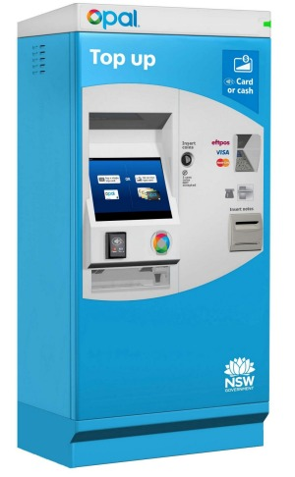
Future’s plan
Install top up machines at bus stops
Top up by credit card or by cash

Slide 118



Future’s plan
Install top up app at convenience store

Slide 119
Thank you for your listening

